Slide 1
Advanced Basic UNIX Commands
Essential commands for efficient UNIX/Linux usage

Slide 2
grep Command
Search for patterns in text
Example:
grep "pattern" filename

Slide 3
find Command
Search for files and directories
Example:
find /path -name "filename"

Slide 4
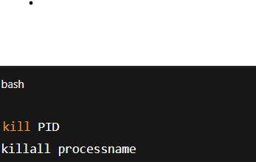
kill / killall Command
Terminate processes
Examples:
kill PID
killall processname

Slide 5
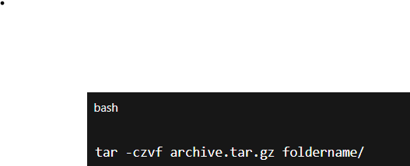
tar Command
Archive and compress files
Example:
tar -czvf archive.tar.gz foldername/

Slide 6
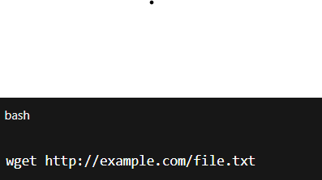
wget Command
Download files from the web
Example:
wget http://example.com/file.txt

Slide 7
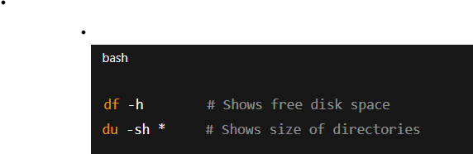
df & du Command
Check disk usage
Examples:
df -h
du -sh *

Slide 8
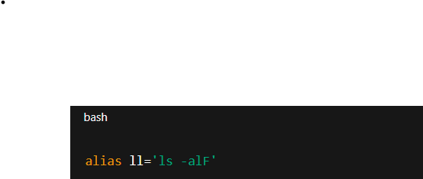
alias Command
Create command shortcuts
Example:
alias ll='ls -alF'

